Slide 1
Welcome to PowerPoint 2019
Deborah Ashby

Slide 2
What to Expect
Creating a presentation
Slide best practices
Adding and editing slides
Graphics
Animation
Video
Presenting your presentation

Slide 3
Wanderlust Travel Benefits
20% discount for new customers
Book your first trip with us and receive a 20% discount on the balance
Dedicated Facebook group
Get to know your group before you leave
Free gift
Receive a free book relevant to your destination to get you in the mood
Information pack
Receive an information pack with packing lists and destination information

Slide 4




Booking Process
Select Destination
Complete online form
Pay deposit
Pay Balance 90 days before departure

Slide 5


Best Selling Destinations
Thailand
Italy

Slide 6

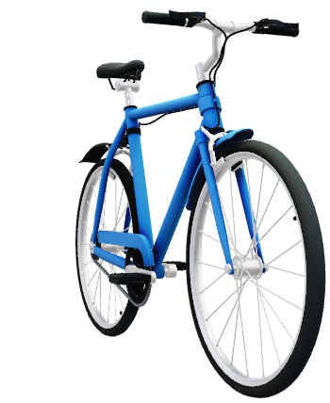


Optional Activities

Slide 7
Most popular trips by sales

Slide 8
About Us
CEO
Marcus Little
Head of Travel Operations
Rachel Marie Jones
Customer Service Lead
Daniel Marsden

Slide 9

Book Now!
Book now and receive a 20% new customer discount!

